Slide 1




Widgets

Slide 2
Contents
What is Widget?
Widget Tree
Types of Widgets
Widgets State
Widgets Lifecycle

Slide 3
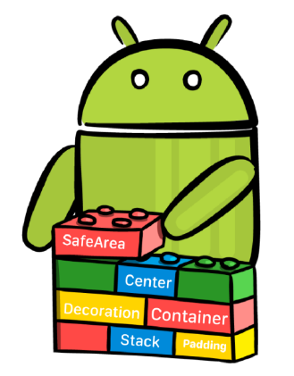
What is Widget?
Widget is the basic building block of Flutter apps.
User Interface in flutter is nothing more than the arrangement of widgets.
Using widgets is like combining Legos. Like Legos, you can mix and match widgets to create something amazing.

Slide 4
What is Widget? cont. . .
Each element on a screen of the Flutter app is a widget, therefore whenever you are going to code for building anything in Flutter, it will be inside a widget.
To build an app Widgets are nested with each other.
Flutter has a rich set of in-built widgets like text, buttons, sliders, lists, layouts, gesture detectors, animations, etc.

Slide 5
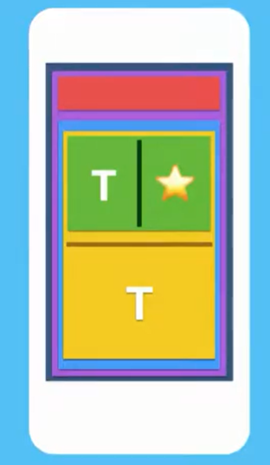
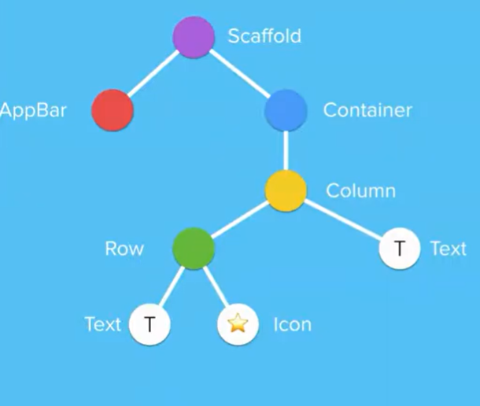
Widget Tree
To develop an interface in a flutter, widgets are arranged into a tree of parent and child widgets.
Widgets are nested inside of each other to form your app.
The Entire widget tree forms a layout that you see on the screen.

Slide 6
Types of Widgets
We can split the Flutter widget into two categories:
Visible (Output and Input): These widgets are related to the user input and output data. Some of the important are
Text, Button, Image, Icon, etc.
Invisible (Layout and Control): The invisible widgets are related to the layout and control of widgets. It provides controlling how the widgets behave and how they will look on the screen. some of the important are
Column, Row, Center, Padding, Scaffold, Stack

Slide 7
Widget State Management
The state is information that
Can be read synchronously when the widget is built
And might change during the lifetime of the widget.
In other words, a state is data that a widget can hold, which is available after the widget is rendered/rebuilt.
In Flutter, there are mainly two types of widgets:
Stateless Widget
Stateful Widget

Slide 8
Stateless Widget
These do not have state information. It remains static throughout its lifecycle.
Stateless widgets don’t store any state. That means they don’t store values that might change.
You can also say that stateless widgets are “DATALESS” widgets. As they don’t store any real-time data.
For example, if you have a simple Text widget on the screen, but it doesn’t do anything then it’s a Stateless Widget.
Examples are Text, Row, Column, Container, etc. This is also known as an Immutable state that can NOT be changed during runtime.

Slide 9
Stateful Widget
These are dynamic because they can change the inner data during the widget’s lifetime.
The user can interact with a stateful widget. For example, If you press a button and it performs any task it’s a Stateful Widget If you are moving a slider and it does anything then it’s a Stateful Widget, If you swipe an item from a list and an item gets deleted then that list a Stateful Widget.
Examples: Checkbox, Radio, Slider, InkWell, Form, and TextField.

Slide 10
Widget Lifecycle
The lifecycle of the Flutter App is the show of how the application will change its State. As we know, Everything in Flutter is a Widget, and Widgets can be
Stateless Widgets: Stateless Widgets don’t change their state at runtime. To represent a widget in stateless
class MyApp extends StatelessWidget { @override Widget build(BuildContext context) { return Container();}}
Stateful Widgets: Stateless widgets can change their state at runtime. To represent a widget in statefull
class MyApp extends StatefulWidget { @override _MyAppState createState() => _MyAppState(); } class _MyAppState extends State<MyApp> { @override Widget build(BuildContext context) { return Container();}}

Slide 11
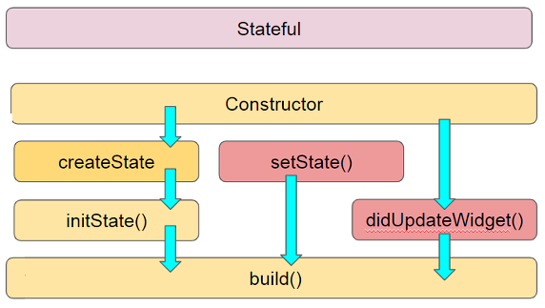
Stateful Widget Lifecycle
createState: When the Framework is instructed to build a StatefulWidget, it immediately calls createState().
initState(): Called when this object is inserted into the tree. It is called only once in widget life. Here you can do some initialization, such as initialization State variables.
didUpdateWidget(): Called whenever the widget configuration changes
setState(): called often from the Flutter framework itself and from the developer.
build: This is the main function and is called each time when we need to render the UI Widgets on the screen

Slide 12
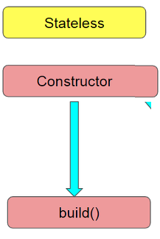
Stateless Widget Lifecycle
Stateless Widget Lifecycle consist only build() function. It has no state, so it can’t change according to an internal state, they only react to higher widget changes.
The build function in the widget creates the content to be displayed on the screen.

Slide 13
Layout Widgets
The layout is a user interface design pattern that refers to defining how the widgets are displayed on the screen relative to each other.
Flutter categories layout widgets into two types
Single Child Widget
Multi-Child Widget

Slide 14

Thank
You !

